Slide 1
Algorithms and Complexities Introduction
刘盛云

Slide 2
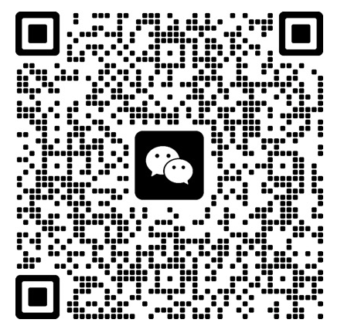
Course
星期四 14：00-15:40 东中院2-206
办公室: 软件大楼5209办公室
邮箱：shengyun.liu@sjtu.edu.cn
平时成绩：10%
练习：课程中给出（Canvas提交），20%
考试：判断题，算法（分析）题，70%
微信群

Slide 3
教材
Cormen, T. H., Leiserson, C. E., Rivest, R. L., & Stein, C. (2022). Introduction to algorithms. MIT press. Fourth edition.
C. Cachin, R. Guerraoui, L. Rodrigues. Introduction to Reliable and Secure Distributed Programming, Springer.

Slide 4
学习算法的意义
计算机科学的研究内容
自动机理论
分布式计算
……
计算机应用
数据库系统
高性能计算技术
分布式系统
……
算法来源于这些研究内容并提供有效的工具

Slide 5
本课程学习的目标
成为合格的软件工程师
能够运用常用的算法
为工作中遇到的问题设计高效的算法
为实际问题建立模型，设计有效的解决方法
掌握理论计算基础
为进一步研究计算复杂度理论打下基础

Slide 6
Algorithm: definition
An algorithm is any well-defined computational procedure that takes some value, or set of values, as input and produces some value, or set of values, as output in a finite amount of time
A (sequential) algorithm is a sequence of computational steps that transform the input into the output

Slide 7
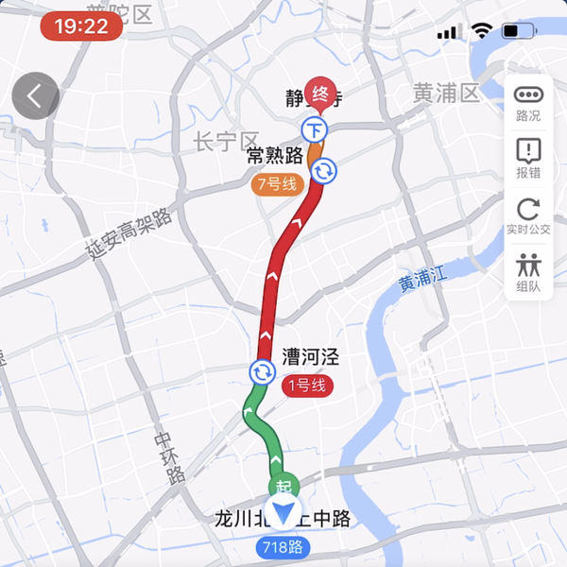
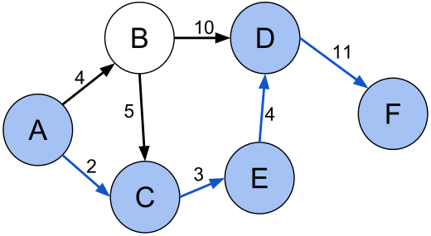
Example: shortest path
A road map on which the distance between each pair of adjacent intersections is marked
Determine the shortest route from one intersection to another
navigation app

Slide 8
Correctness
An algorithm for a computational problem is correct if,
(liveness) for every problem instance provided as input, it halts --- finishes its computing in finite time, and
(safety) outputs the correct solution to the problem instance
An incorrect algorithm might not halt at all on some input instances, or it might halt with an incorrect answer

Slide 9
Efficiency
Different algorithms devised to solve the same problem often differ dramatically in their efficiency
Complexity analysis
determines the amount of (time and space) resources required to execute an algorithm
Goal: finding the “best” solution among a group of candidates

Slide 10
Goal
Encounter a problem for which you cannot find a published algorithm
Total system performance depends on choosing efficient algorithms as much as on choosing fast hardware
Analyzing an algorithm has come to mean predicting the resources that the algorithm requires
Computational time
Memory
Communication bandwidth (communication complexity)
Energy consumption
Identify the most efficient one

Slide 11
Sequential algorithms
An algorithm that is executed sequentially–once through, from start to finish, without other processing executing
No concurrency

Slide 12
Part I: sequential algorithms
Techniques
Divide-and-Conquer
Dynamic Programming
Greedy Algorithms
Algorithms
Graph Algorithms
Minimum Spanning Trees
(Single-source) Shortest Paths
NP-Completeness problems
Traveling-salesperson problem
Some of them arise often in real applications

Slide 13
Distributed Algorithms
Algorithms used in distributed systems
In contrast to sequential algorithms for centralized systems
What is a distributed system?
A set of processes/nodes
seeking to achieve some common goal
by communicating with each other
Processes/nodes: cores, processors, physical/virtual machines, clusters

Slide 14





The simplest form of distributed systems
Client–server interactions
monthly active users: 172 million
Game of Thrones

Slide 15


Another scenario
Client–server interactions
monthly active users: 700 million
transfer(Alice, Bob, ¥10)
confirm
confirm
Alice
Bob

Slide 16








One more scenario
transfer(From: Alice, To: Bob, Amount: 1)
…
$$B_{0}$$
$$B_{1}$$
…
$$B_{h}$$
…
Blockchain
1
consensus
Alice
1
Bob

Slide 17
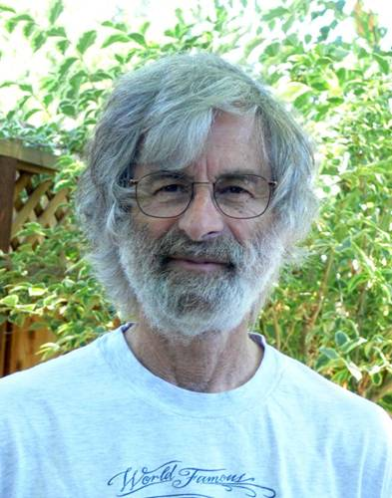
Lamport's Turing lecture
The Computer Science of Concurrency: The Early Years
“I don’t know if concurrency is a science, but it is a field of computer science.”

Slide 18
Part II: distributed algorithms
Basic abstractions
Timing assumption
Fault detection
Leader election
Broadcast
Reliable broadcast
Causal-order broadcast
Consensus
Paxos

Slide 19
数据结构与算法
计算机语言、数据结构与算法课程的关系
计算机语言是工具
数据结构与算法是内容
算法用来设计解决问题的方法
程序=数据结构+算法
数据结构与算法课程的内容
算法研究利用计算机加工使用数据的方法
数据结构表达复杂的计算机中的复杂数据类型

Slide 20
例子：信息查询
信息的组织方式
姓名 性别 年龄 住址
信息的排列方式
表格
如何快速有效的找到所需信息
顺序查找
二分查找

Slide 21
算法能解决所有问题吗
暂时不能在有效的时间内解决所有问题
本课程给出一些高效的算法，但是有些问题至今没有有效的解法
这些“困难”问题的一个有趣的子集是NP完全问题。如果遇到的一个问题可以等效为NP完全问题，那么请暂时不要试图去解决它

Slide 22
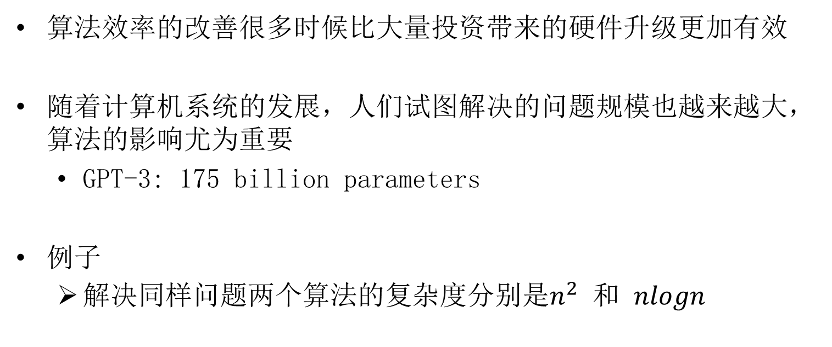
算法及其复杂度研究重要吗
算法效率的改善很多时候比大量投资带来的硬件升级更加有效
随着计算机系统的发展，人们试图解决的问题规模也越来越大，算法的影响尤为重要
GPT-3: 175 billion parameters
例子
解决同样问题两个算法的复杂度分别是$n^{2}$ 和 $nlogn$

Slide 23

Example: sorting
Input: A sequence of $n$ numbers $<a_{1},a_{2},…,a_{n}>$.
Output: A permutation (reordering) $<a_{1}^{′},a_{2}^{′},…,a_{n}^{′}>$ of the input sequence such that $a_{1}^{′}≤a_{2}^{′}≤…≤a_{n}^{′}$

Slide 24
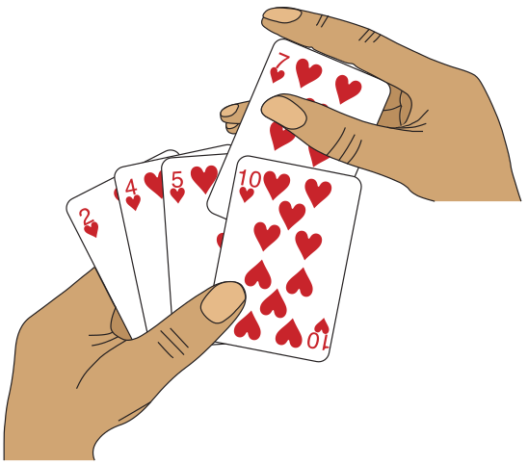
Insertion sort
Insertion sort works like sorting a hand of playing cards

Slide 25
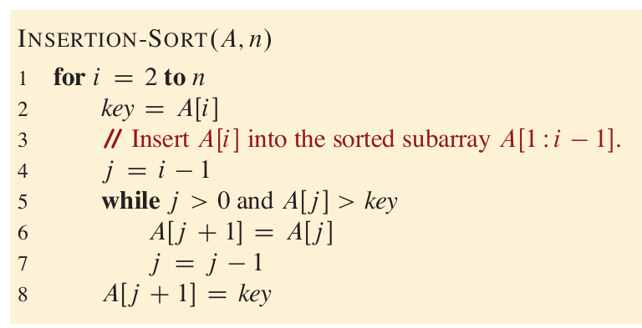
Insertion sort pseudocode
Pseudocode
Similar in many respects to C, C++, Java, Python
Take [5, 7, 3, 4, 2] for example

Slide 26
Correctness
loop invariant:
At the start of each iteration of the for loop of lines 1-8, the subarray A[1,i-1] consists of the elements originally in A[1,i-1], but in sorted order
Initialization: It is true prior to the first iteration of the loop
Maintenance: If it is true before an iteration of the loop, it remains true before the next iteration
Termination: The loop terminates

Slide 27
Insertion sort：efficiency
How do you analyze its efficiency?
We need a way to predict, given a new input, how long insertion sort will take
Quantify input size：depends on the problem being studied
the number of items in the input
indicate which input size measure is being used with each problem we study

Slide 28
Computation model
Random-access machine (RAM) model of computation
The RAM model contains instructions commonly found in real computers
Arithmetic: add, subtract, multiply, divide
Data movement: load, store, copy
Control: conditional and unconditional branch
Each instruction takes the same amount of time
Instructions execute one after another, with no concurrency
Data types: integer, floating point and character

Slide 29
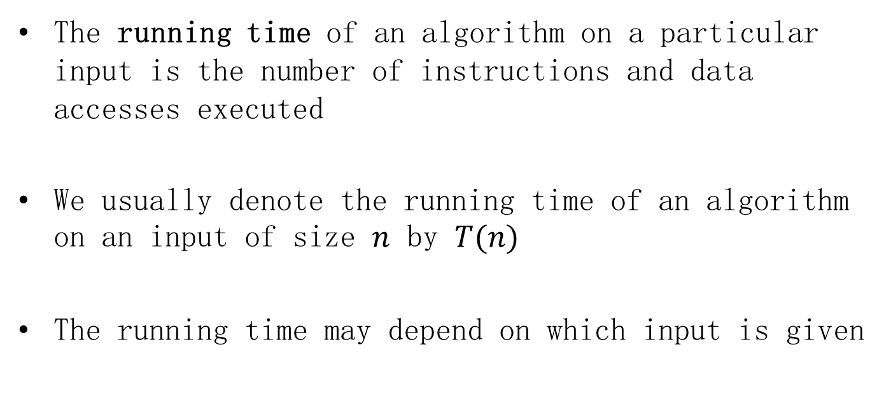
Running time
The running time of an algorithm on a particular input is the number of instructions and data accesses executed
We usually denote the running time of an algorithm on an input of size $n$ by $T(n)$
The running time may depend on which input is given

Slide 30
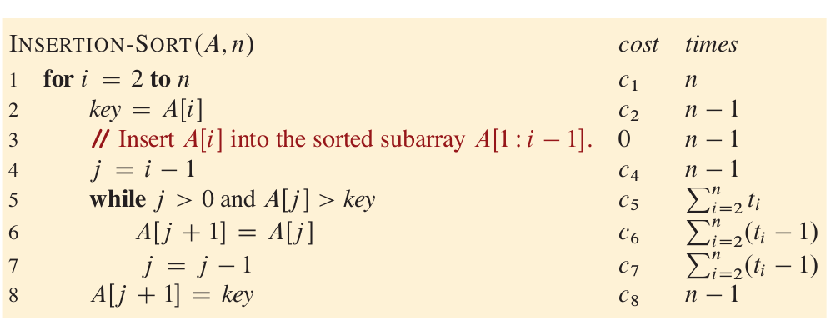
Example：Insertion sort
Describe the running time of a program as a function of the size of its input
$$T\left(n\right)=c_{1}n+c_{2}\left(n−1\right)+c_{4}\left(n−1\right)+c_{5}\sum_{i=2}^{n}{t_{i}}+c_{6}\sum_{i=2}^{n}{{(t}_{i}−1)}+c_{7}\sum_{i=2}^{n}{{(t}_{i}−1)}+c_{8}\left(n−1\right)$$

Slide 31
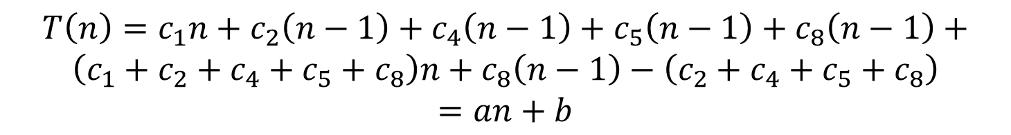

Insertion sort best-case running time
Best-case: when the array is already sorted
1 2 3 4 5
The running time is thus a linear function of $n$
$$T\left(n\right)=c_{1}n+c_{2}\left(n−1\right)+c_{4}\left(n−1\right)+c_{5}\left(n−1\right)+c_{8}\left(n−1\right)+$$
$$\left(c_{1}+c_{2}+c_{4}+c_{5}+c_{8}\right)n+c_{8}\left(n−1\right)−\left(c_{2}+c_{4}+c_{5}+c_{8}\right)$$
$$=an+b$$

Slide 32

Insertion sort worst-case running time
Worst-case: when the array is in reverse sorted order
5 4 3 2 1
$t_{i}=i$ for $i=2, 3, …, n$
The while loop exits only when $j$ reaches 0

Slide 33
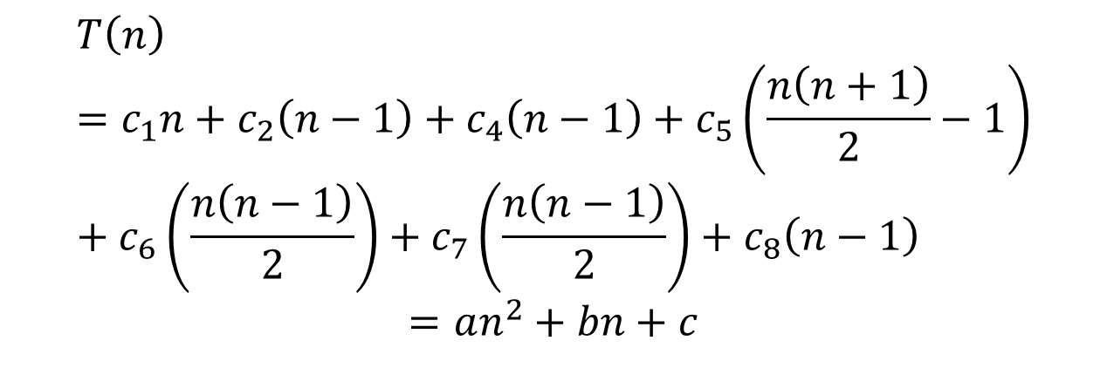

Insertion sort worst-case running time
$\sum_{i=2}^{n}{i}=\sum_{i=1}^{n}{i}−1=\frac{n\left(n+1\right)}{2}−1$, $\sum_{i=2}^{n}{\left(i−1\right)=}\frac{n\left(n−1\right)}{2}$
$$T\left(n\right)=c_{1}n+c_{2}\left(n−1\right)+c_{4}\left(n−1\right)+c_{5}\left(\frac{n\left(n+1\right)}{2}−1\right)+c_{6}\left(\frac{n\left(n−1\right)}{2}\right)+c_{7}\left(\frac{n\left(n−1\right)}{2}\right)+c_{8}\left(n−1\right)$$
$$=an^{2}+bn+c$$

Slide 34
Worst-case and average-case analysis
Typically, the running time of an algorithm is fixed for a given input
We usually (but not always) concentrate on finding only the worst-case running time
an upper bound on the running time for any input

Slide 35
Order of growth (增长量级)
To ease the analysis of any algorithm
Consider only the leading term of a formula
an approximation of the time
lower-order terms are relatively insignificant
Consider one algorithm to be more efficient than another if
its worst-case running time has a lower order of growth
Ignore the leading term's constant coefficient

Slide 36
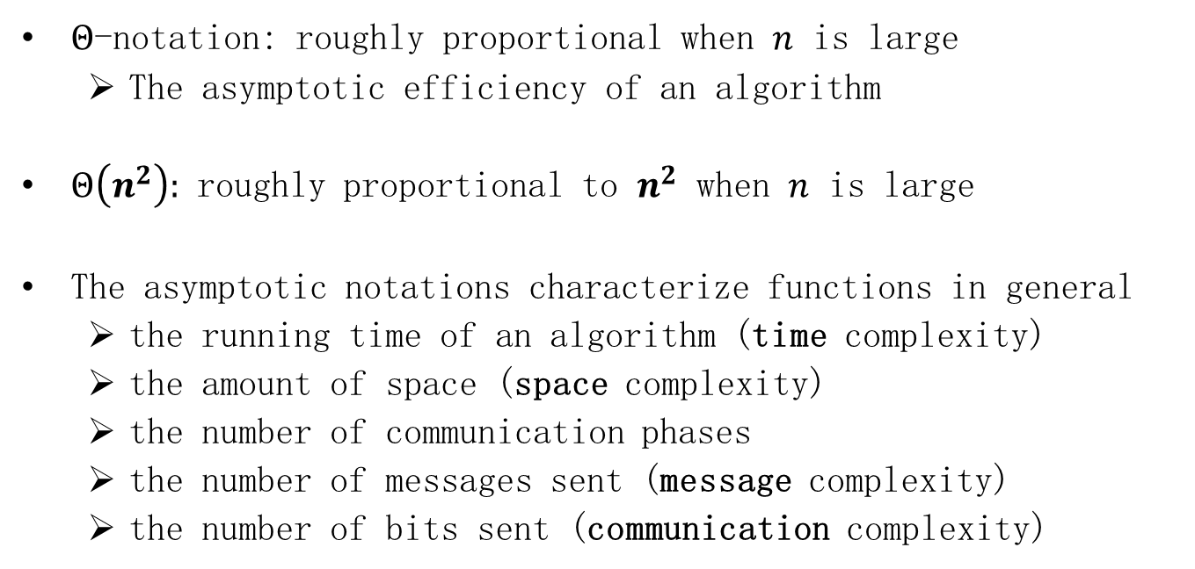
Order of growth
$Θ$-notation: roughly proportional when $n$ is large
The asymptotic efficiency of an algorithm
$Θ\left(n^{2}\right):$ roughly proportional to $n^{2}$ when $n$ is large
The asymptotic notations characterize functions in general
the running time of an algorithm (time complexity)
the amount of space (space complexity)
the number of communication phases
the number of messages sent (message complexity)
the number of bits sent (communication complexity)

Slide 37
Divide-and-conquer
Divide the problem into one or more subproblems that are smaller instances of the same problem
Conquer the subproblems by solving them recursively
Combine the subproblem solutions to form a solution to the original problem

Slide 38
Merge sort: general idea
Divide the subarray A[p,r] to be sorted into two adjacent subarrays, each of half the size
Compute the midpoint q of A[p,r]
Divide A[p,r] into subarrays A[p,q] and A[q+1,r]
Conquer by sorting each of the two subarrays A[p,q] and A[q+1,r] recursively using merge sort
Combine by merging the two sorted subarrays A[p,q] and A[q+1,r] back into A[p,q], producing the sorted answer

Slide 39
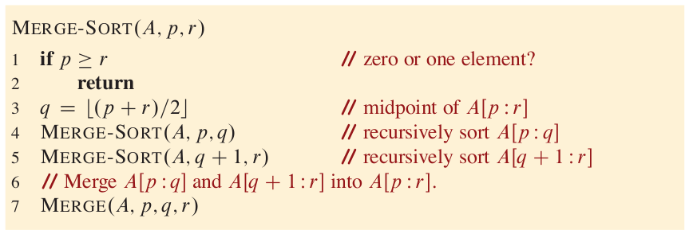
Merge sort - 1

Slide 40
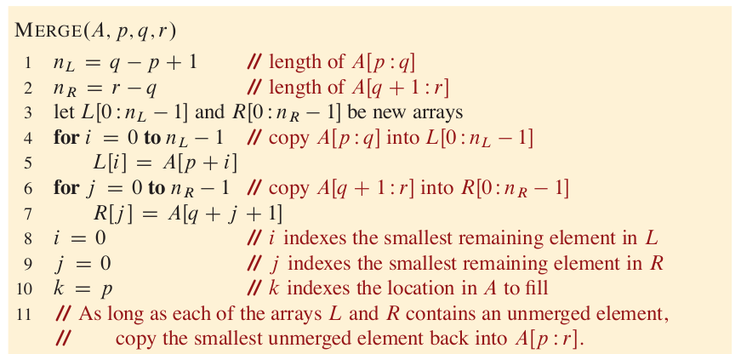
Merge sort - 2

Slide 41
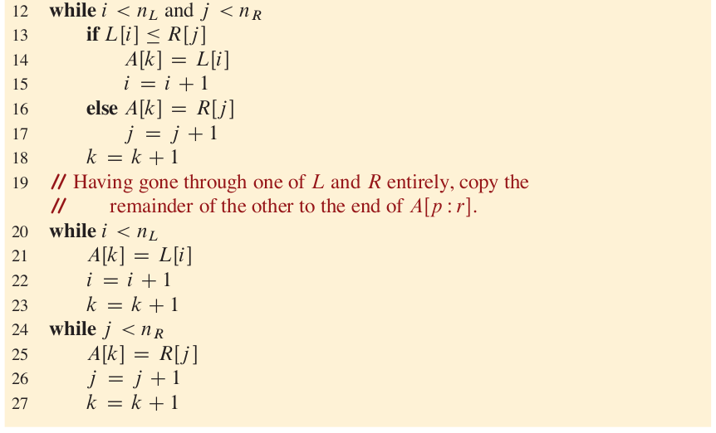
Merge sort - 3

Slide 42
Merge sort: example
Take [3, 5, 2, 6, 4, 1, 8, 7] for example
[1, 2, 3, 4, 5, 6, 7, 8]
[2, 3, 5, 6], [1, 4, 7, 8]
[3, 5], [2, 6], [1, 4], [7, 8]
[3] [5] [2] [6] [4] [1] [8] [7]

Slide 43

Merge sort: efficiency
Recurrence equation
$T\left(n\right)=\left\{\begin{aligned}c_{1}, if n=1 \\ 2T\left(\frac{n}{2}\right)+c_{2}n,if n>1\end{aligned}\right.$

Slide 44







Recurrence tree
$$c_{2}n$$
$c_{2}n/2$, $c_{2}n/2$
$c_{2}n/4$, $c_{2}n/4$, $c_{2}n/4$, $c_{2}n/4$
…
$c_{1}$, $c_{1}$, $c_{1}$, $c_{1}$, $c_{1}$, $c_{1}$, $c_{1}$, $c_{1}$
$$c_{2}n$$
$$c_{2}n$$
$$logn$$
$$c_{2}n$$
…
…
…
…
…
…
…
…
$$c_{1}n$$
$$c_{2}nlogn+c_{1}n=Θ\left(nlogn\right)$$

Slide 45

Notations: upper bound
$O$-notation: characterizes an upper bound on the asymptotic behavior of a function
a function grows no faster than a certain rate

Slide 46
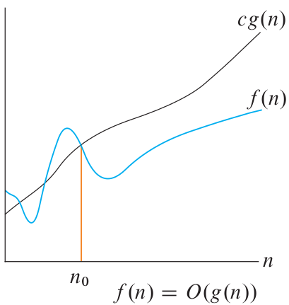

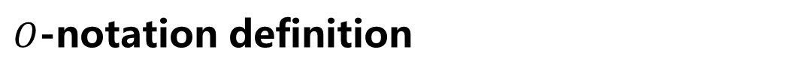
$O$-notation definition
there exist positive constants $c$ and $n_{0}$ such that
$0≤f(n)≤cg(n)$ for all $n≥n_{0}$

Slide 47

Notations: lower bound
$Ω$-notation: characterizes a lower bound on the asymptotic behavior of a function
a function grows at least as fast as a certain rate

Slide 48
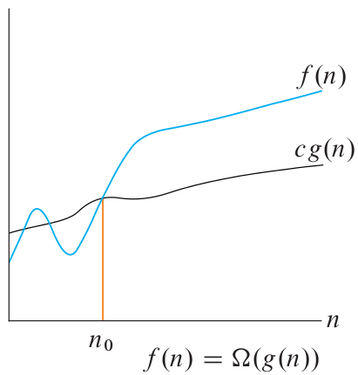

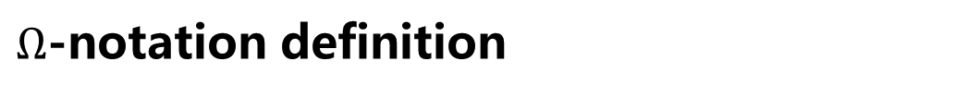
$Ω$-notation definition
there exist positive constants $c$ and $n_{0}$ such that
$0≤cg(n) ≤f(n)$ for all $n≥n_{0}$

Slide 49
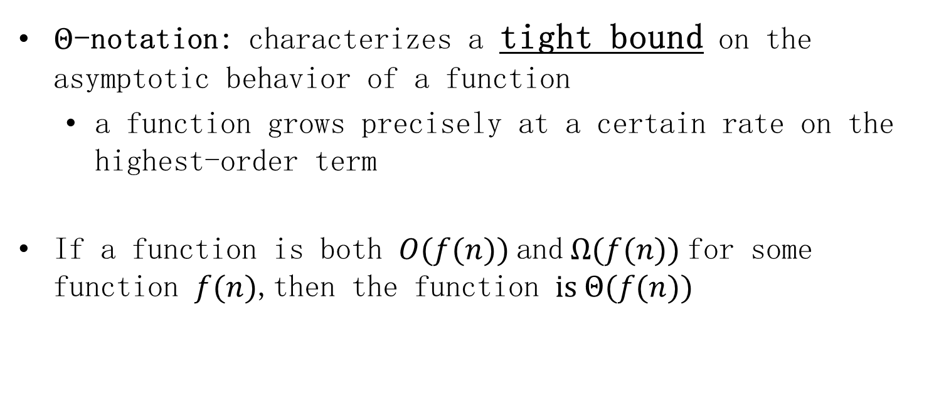
Notations: tight bound
$Θ$-notation: characterizes a tight bound on the asymptotic behavior of a function
a function grows precisely at a certain rate on the highest-order term
If a function is both $O(f(n))$and $Ω(f(n))$for some function $f(n)$,then the function is $Θ(f(n))$
Notes:
Put another way, $Θ$-notation characterizes the rate of growth of the function to within a constant factor from above and to within a constant factor from below.

Slide 50
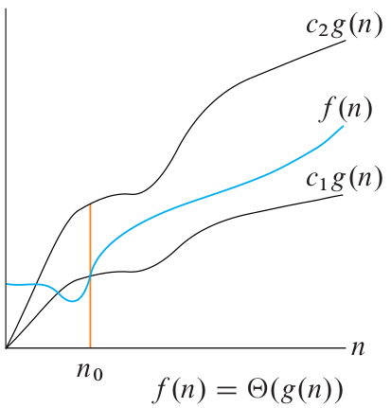

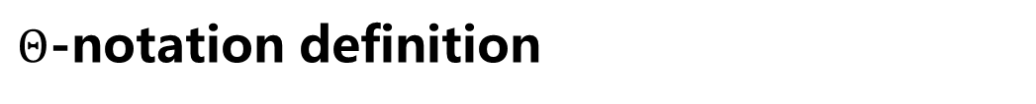
$Θ$-notation definition
there exist positive constants $c_{1}$, $c_{2}$ and $n_{0}$ such that
$0≤c_{1}g(n) ≤f(n)≤c_{2}g(n)$ for all $n≥n_{0}$

Slide 51
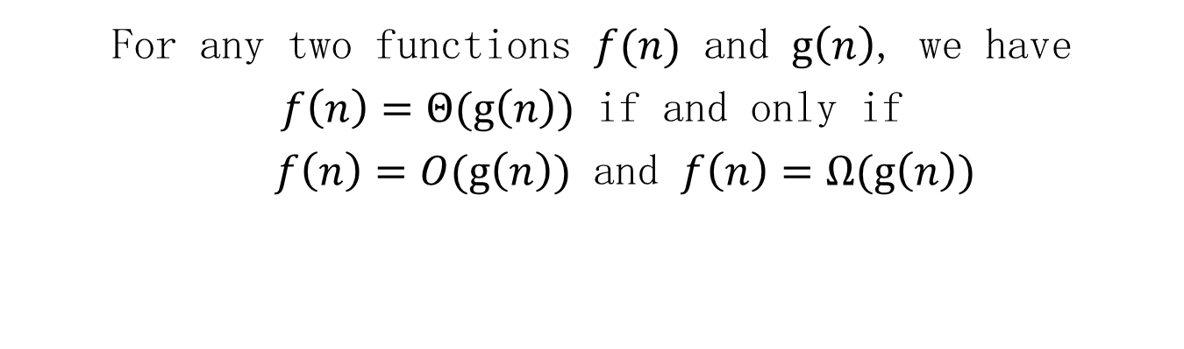
Important theorem
For any two functions $f(n)$ and $g\left(n\right)$, we have
$f\left(n\right)=Θ(g\left(n\right))$ if and only if
$f\left(n\right)=O(g\left(n\right))$ and $f\left(n\right)=Ω(g\left(n\right))$

